Slide 1




G98/G99 Database Consultancy Support
Adam Maloyd, Principal Power Systems Engineer
Jack Tillett, Graduate Power Systems Engineer

Slide 2
G98/G99 Database Consultancy Support
WSP Power Systems Team
3rd November 2020

Slide 3
Structure
Part 1 Introduction & Type Test Register Update | Part 2 Walkthrough of Assessment Procedure
WSP Team Introduction | G98 Form C – 3kW Energy Storage Device Example
Brief Introduction to Assessment Procedure & Common Issues | G99 Form A2-3 – 18kW 3-phase Inverter Example
The Type Test Register | Devices > 50kW
Compliant/Non-compliant Examples
Q&A Throughout
Notes:
ENA has recently established the G98/99 Database Consultancy Support. Project, the objectives of which are as follows:
1. Review manufacturer and supplier information submitted to the ENA G98/99
Database.
2. Assess information submitted in accordance with requirements of ENA documents
EREP G98 “Requirements for the connection of fully type tested micro-generators (up
to and including 16A per phase) in parallel with public Low Voltage Distribution
Networks on or after 27th April 2019” and EREP G99 “Requirements for the connection
of generation equipment in parallel with public distribution networks on or after 27th
April 2019”.
3. Provide a report on compliance of equipment with requirements of G98/99 or a report
of non-compliance where the equipment has partially or fully failed to meet the
requirements.
4. Communicate report to stakeholders

Slide 4
Our team
Our team
  48 FTEs by the end 2019
  Highly qualified and skilled: ~1/3 PhDs and MBAs!
4

Slide 5
ENA G98/G99 Consultancy Support
Anna Ferguson
Power Systems
Sector Lead
Jack Tillett
Graduate Power
Systems Engineer
Adam Maloyd
Project Manager

Slide 6
Project Scope
The G98/99 database is designed to provide assurance to DNOs that plant and equipment connected is compliant with the requirements of RfG, G98 and G99.
G59/G83 compliance requirements have been updated to G98/99 and kept as close as possible to the grid codes.
ENA established the G98/99 Database back in early 2019.
Suppliers have been submitting data to the database since March 2019
WSP have undertaken continuation of reviews since 11th September 2019.
Notes:
ENA has recently established the G98/99 Database Consultancy Support. Project, the objectives of which are as follows:
1. Review manufacturer and supplier information submitted to the ENA G98/99
Database.
2. Assess information submitted in accordance with requirements of ENA documents
EREP G98 “Requirements for the connection of fully type tested micro-generators (up
to and including 16A per phase) in parallel with public Low Voltage Distribution
Networks on or after 27th April 2019” and EREP G99 “Requirements for the connection
of generation equipment in parallel with public distribution networks on or after 27th
April 2019”.
3. Provide a report on compliance of equipment with requirements of G98/99 or a report
of non-compliance where the equipment has partially or fully failed to meet the
requirements.
4. Communicate report to stakeholders

Slide 7
Project Scope
Review manufacturer and supplier information submitted to the ENA G98/99 Database.
Assess information submitted in accordance with requirements of ENA documents.
Contact manufacturers detailing issues found in submitted information
(or lack of).
Provide confidence to ENA & DNOs for devices to be used in connection applications.
Construct a detailed and formal review method which can be adopted by ENA/DNOs.
Notes:
ENA has recently established the G98/99 Database Consultancy Support. Project, the objectives of which are as follows:
1. Review manufacturer and supplier information submitted to the ENA G98/99
Database.
2. Assess information submitted in accordance with requirements of ENA documents
EREP G98 “Requirements for the connection of fully type tested micro-generators (up
to and including 16A per phase) in parallel with public Low Voltage Distribution
Networks on or after 27th April 2019” and EREP G99 “Requirements for the connection
of generation equipment in parallel with public distribution networks on or after 27th
April 2019”.
3. Provide a report on compliance of equipment with requirements of G98/99 or a report
of non-compliance where the equipment has partially or fully failed to meet the
requirements.
4. Communicate report to stakeholders

Slide 8
Assessment Procedure

Slide 9
Stages of Assessment
Review device using corresponding Excel Assessment tool.
If device is compliant - update Type Test register.
If device is not compliant, contact manufacturer using automated email service (TBC).
If initial manufacturer communications resolve issues, request resubmission of data.
  If not, begin a constructive dialogue with manufacturers.
  Work with manufacturers as we all have the same goal.
Preliminary review of manufacturers device application prior to upload on TTR – prevents cluttering of version/amendment No’s.
Notes:
ENA has recently established the G98/99 Database Consultancy Support. Project, the objectives of which are as follows:
1. Review manufacturer and supplier information submitted to the ENA G98/99
Database.
2. Assess information submitted in accordance with requirements of ENA documents
EREP G98 “Requirements for the connection of fully type tested micro-generators (up
to and including 16A per phase) in parallel with public Low Voltage Distribution
Networks on or after 27th April 2019” and EREP G99 “Requirements for the connection
of generation equipment in parallel with public distribution networks on or after 27th
April 2019”.
3. Provide a report on compliance of equipment with requirements of G98/99 or a report
of non-compliance where the equipment has partially or fully failed to meet the
requirements.
4. Communicate report to stakeholders

Slide 10

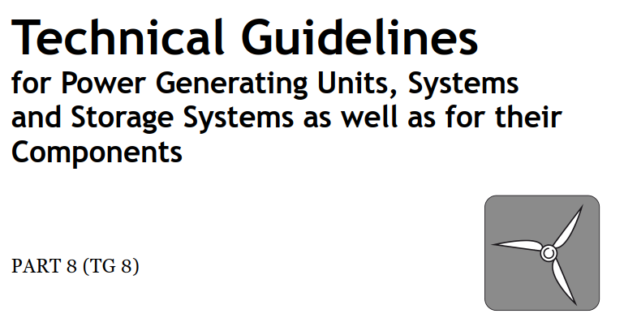
German Technical Guideline – TG8
Accepted family rule for ENA/DNO’s
German Technical Guidelines for Power Generating Units (PGUs)
Type 1 PGUs (Synchronous generators) - Family rule is 1/√10 of apparent power to √10 of apparent power (√10 = 3.16)
Type 2 PGUs (everything else) - family rule is 1/√10 (0.316) of apparent power to 2x apparent power
Example
If 10kW device tested (with results):
Acceptable range of family classification:
3.16 kW < X < 31.6 kW
Notes:
ENA has recently established the G98/99 Database Consultancy Support. Project, the objectives of which are as follows:
1. Review manufacturer and supplier information submitted to the ENA G98/99
Database.
2. Assess information submitted in accordance with requirements of ENA documents
EREP G98 “Requirements for the connection of fully type tested micro-generators (up
to and including 16A per phase) in parallel with public Low Voltage Distribution
Networks on or after 27th April 2019” and EREP G99 “Requirements for the connection
of generation equipment in parallel with public distribution networks on or after 27th
April 2019”.
3. Provide a report on compliance of equipment with requirements of G98/99 or a report
of non-compliance where the equipment has partially or fully failed to meet the
requirements.
4. Communicate report to stakeholders

Slide 11
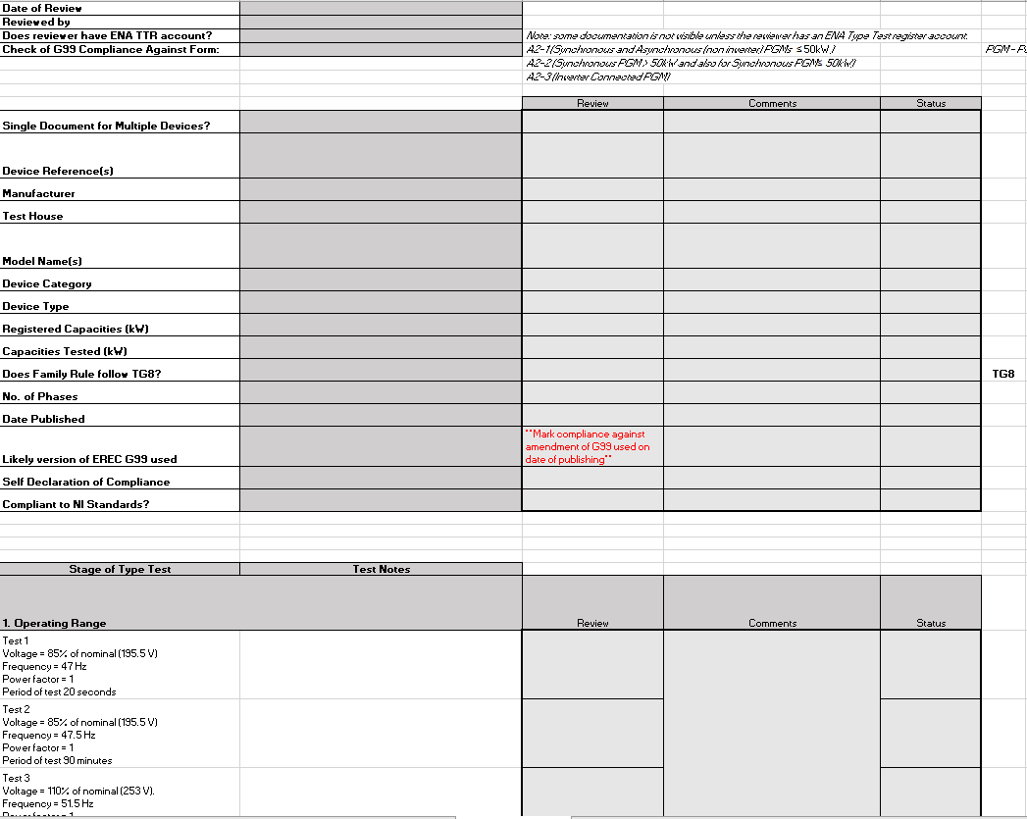

Excel Assessment Tool
Excel tools developed for:
  G98 Form C
  A2-1, A2-2 & A2-3
  A2-4 (Interface Protection Devices).
Each manufacturer has own workbook.
Each worksheet represents a device (or a family).
All information fed back through to Type Test register.
Notes:
ENA has recently established the G98/99 Database Consultancy Support. Project, the objectives of which are as follows:
1. Review manufacturer and supplier information submitted to the ENA G98/99
Database.
2. Assess information submitted in accordance with requirements of ENA documents
EREP G98 “Requirements for the connection of fully type tested micro-generators (up
to and including 16A per phase) in parallel with public Low Voltage Distribution
Networks on or after 27th April 2019” and EREP G99 “Requirements for the connection
of generation equipment in parallel with public distribution networks on or after 27th
April 2019”.
3. Provide a report on compliance of equipment with requirements of G98/99 or a report
of non-compliance where the equipment has partially or fully failed to meet the
requirements.
4. Communicate report to stakeholders

Slide 12
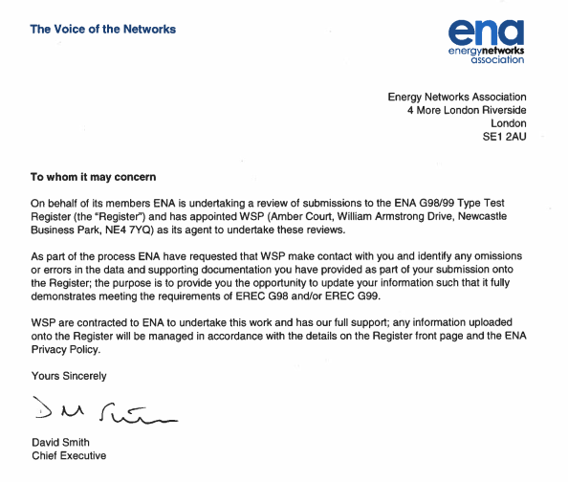
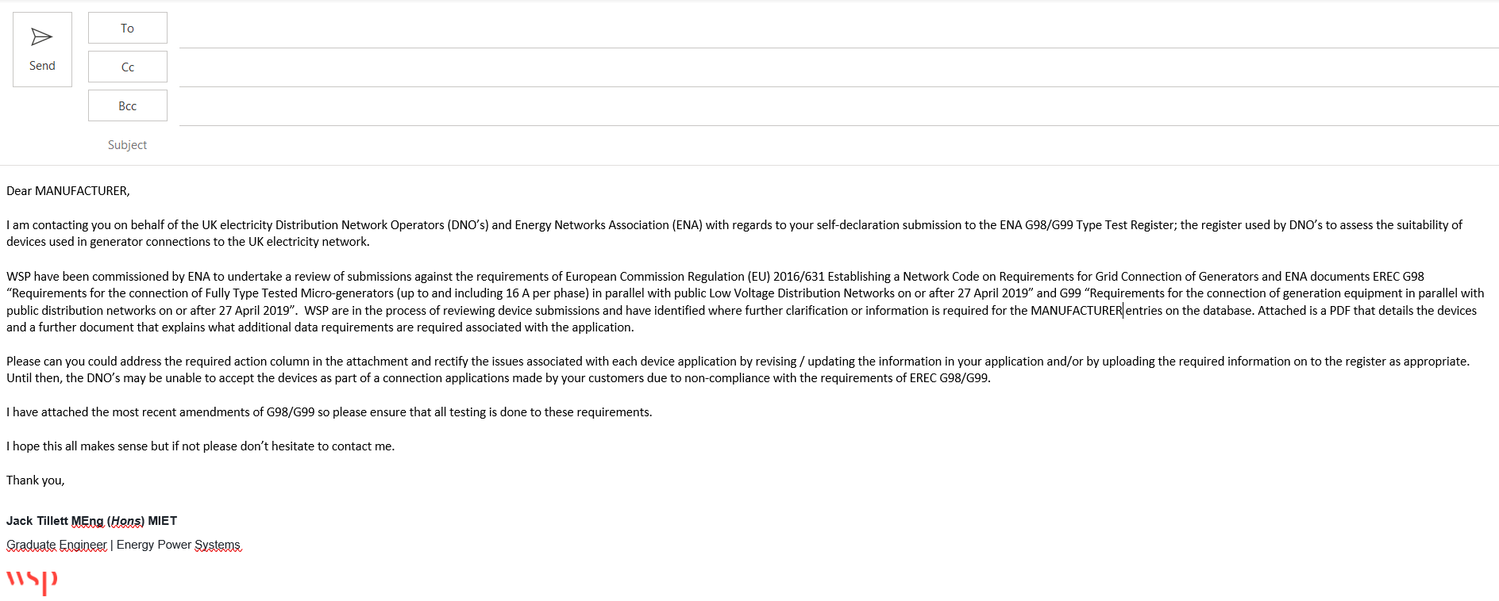
Manufacturer Communications
Previously, WSP would contact the manufacturer’s on a case-by-case basis.
Update in progress to automatically notify manufacturers of any outstanding issues with their devices.
This will use the email address of each manufacturer registered on the TTR.
Notes:
ENA has recently established the G98/99 Database Consultancy Support. Project, the objectives of which are as follows:
1. Review manufacturer and supplier information submitted to the ENA G98/99
Database.
2. Assess information submitted in accordance with requirements of ENA documents
EREP G98 “Requirements for the connection of fully type tested micro-generators (up
to and including 16A per phase) in parallel with public Low Voltage Distribution
Networks on or after 27th April 2019” and EREP G99 “Requirements for the connection
of generation equipment in parallel with public distribution networks on or after 27th
April 2019”.
3. Provide a report on compliance of equipment with requirements of G98/99 or a report
of non-compliance where the equipment has partially or fully failed to meet the
requirements.
4. Communicate report to stakeholders

Slide 13
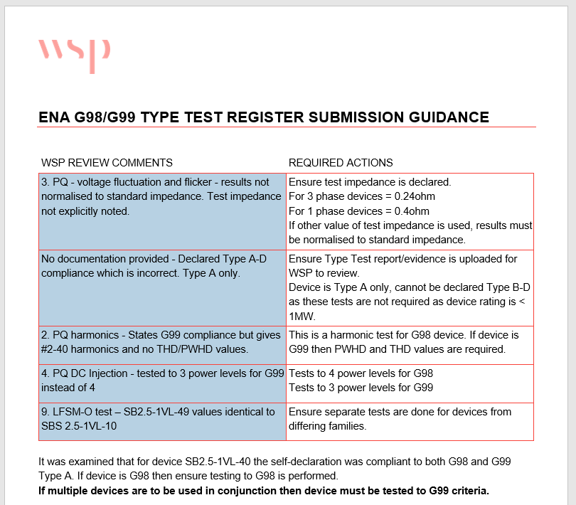
Manufacturer Communications

Slide 14

Common application issues
PQ – DC Injection values either exceed 0.25% or were incorrectly calculated;
PWHD/THD values not provided;
Incorrect declaration to both G98/G99;
Missing confirmation of logic interface;
Issues with voltage fluctuations/flicker (test/standard impedance);
Missing 2nd and 3rd phase harmonic current values;
Harmonic current calculations incorrect;
Fault level contribution missing;
LFSM-O droop exceeded for active power response.
PQ – Power Quality
PWHD – Partially Weighted Harmonic Distortion
THD – Total Harmonic Distortion
LFSM-O – Limited Frequency Sensitive Mode – Over frequency
Notes:
ENA has recently established the G98/99 Database Consultancy Support. Project, the objectives of which are as follows:
1. Review manufacturer and supplier information submitted to the ENA G98/99
Database.
2. Assess information submitted in accordance with requirements of ENA documents
EREP G98 “Requirements for the connection of fully type tested micro-generators (up
to and including 16A per phase) in parallel with public Low Voltage Distribution
Networks on or after 27th April 2019” and EREP G99 “Requirements for the connection
of generation equipment in parallel with public distribution networks on or after 27th
April 2019”.
3. Provide a report on compliance of equipment with requirements of G98/99 or a report
of non-compliance where the equipment has partially or fully failed to meet the
requirements.
4. Communicate report to stakeholders

Slide 15
Guidance Notes
ENA have said there will be no further amendments to G98/G99 for at least a few months.
WSP have developed guidance notes for application forms.
Aim is to prevent these common issues from arising prior to initial upload to TTR.
To be used in conjunction with example submissions (also developed by WSP).
Based on all applications reviewed; should alleviate most common issues found.
Should introduce fluidity during the upload/review process and filter out common documentation problems;
  Missing 2/3 phase harmonic data;
  Incorrect declaration of test/standard impedance;
  Use up-to-date EREC;
  Inclusion of graphical response.
Notes:
ENA has recently established the G98/99 Database Consultancy Support. Project, the objectives of which are as follows:
1. Review manufacturer and supplier information submitted to the ENA G98/99
Database.
2. Assess information submitted in accordance with requirements of ENA documents
EREP G98 “Requirements for the connection of fully type tested micro-generators (up
to and including 16A per phase) in parallel with public Low Voltage Distribution
Networks on or after 27th April 2019” and EREP G99 “Requirements for the connection
of generation equipment in parallel with public distribution networks on or after 27th
April 2019”.
3. Provide a report on compliance of equipment with requirements of G98/99 or a report
of non-compliance where the equipment has partially or fully failed to meet the
requirements.
4. Communicate report to stakeholders

Slide 16
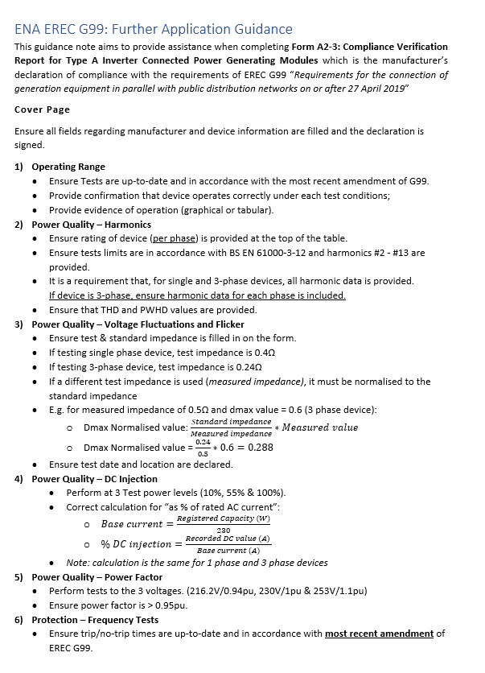
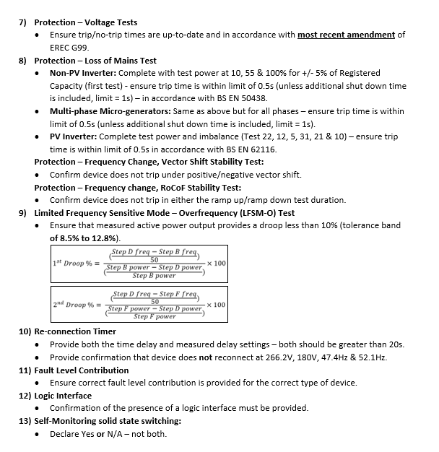
Guidance Notes
*A2-3 guidance note
Notes:
ENA has recently established the G98/99 Database Consultancy Support. Project, the objectives of which are as follows:
1. Review manufacturer and supplier information submitted to the ENA G98/99
Database.
2. Assess information submitted in accordance with requirements of ENA documents
EREP G98 “Requirements for the connection of fully type tested micro-generators (up
to and including 16A per phase) in parallel with public Low Voltage Distribution
Networks on or after 27th April 2019” and EREP G99 “Requirements for the connection
of generation equipment in parallel with public distribution networks on or after 27th
April 2019”.
3. Provide a report on compliance of equipment with requirements of G98/99 or a report
of non-compliance where the equipment has partially or fully failed to meet the
requirements.
4. Communicate report to stakeholders

Slide 17
The Type Test Register

Slide 18
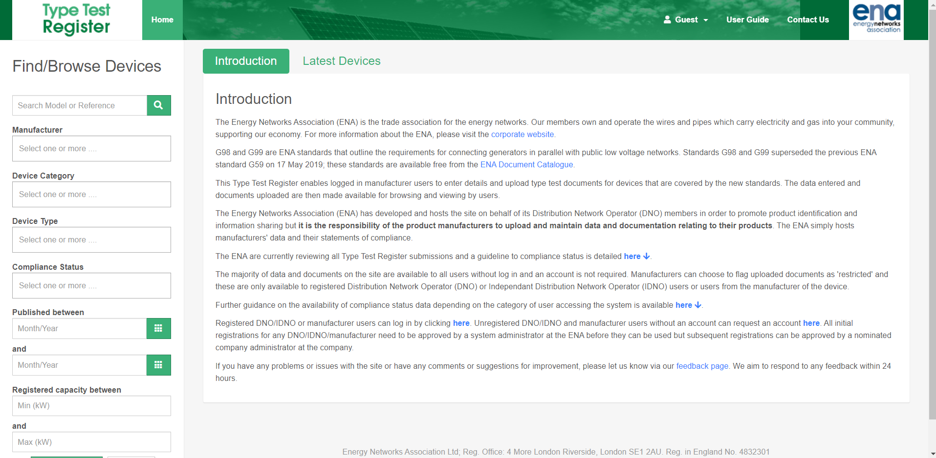
The Type Test Register
Notes:
ENA has recently established the G98/99 Database Consultancy Support. Project, the objectives of which are as follows:
1. Review manufacturer and supplier information submitted to the ENA G98/99
Database.
2. Assess information submitted in accordance with requirements of ENA documents
EREP G98 “Requirements for the connection of fully type tested micro-generators (up
to and including 16A per phase) in parallel with public Low Voltage Distribution
Networks on or after 27th April 2019” and EREP G99 “Requirements for the connection
of generation equipment in parallel with public distribution networks on or after 27th
April 2019”.
3. Provide a report on compliance of equipment with requirements of G98/99 or a report
of non-compliance where the equipment has partially or fully failed to meet the
requirements.
4. Communicate report to stakeholders

Slide 19
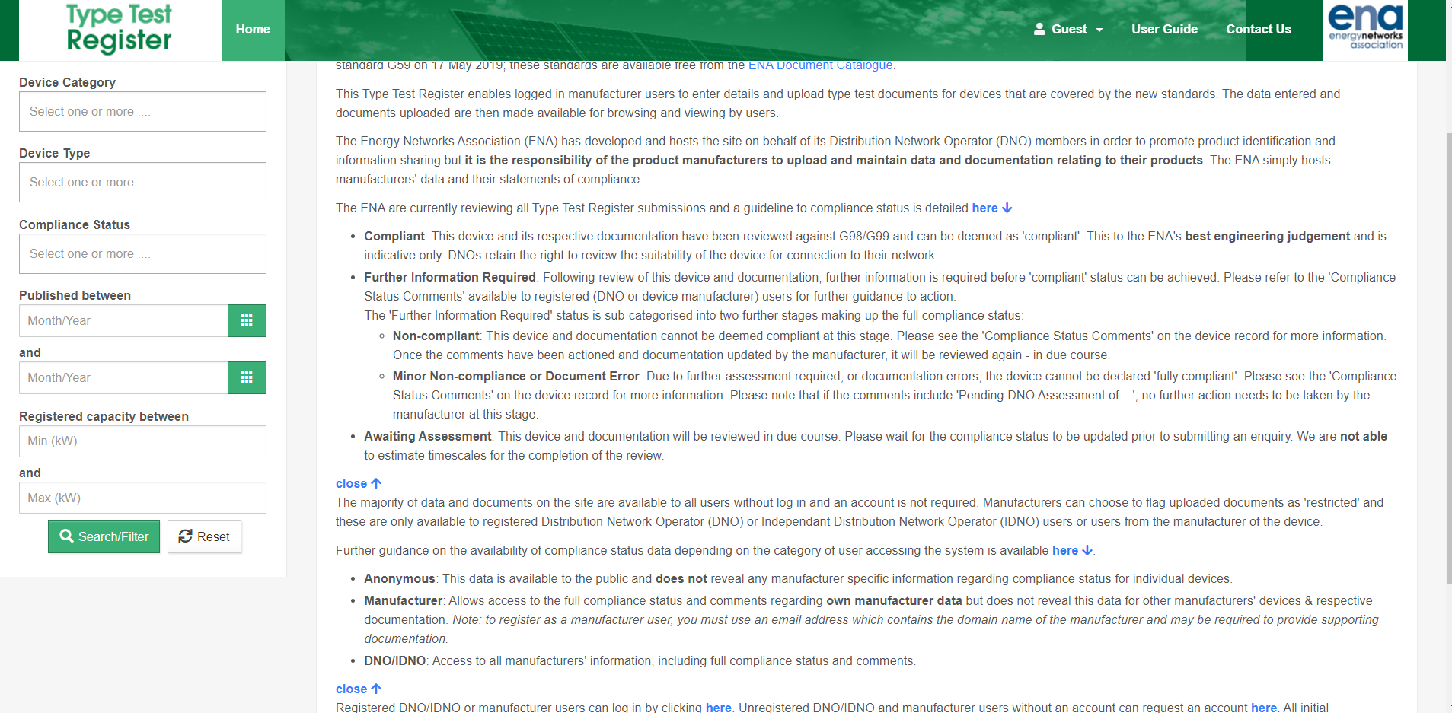
The Type Test Register
Still a WIP
Notes:
ENA has recently established the G98/99 Database Consultancy Support. Project, the objectives of which are as follows:
1. Review manufacturer and supplier information submitted to the ENA G98/99
Database.
2. Assess information submitted in accordance with requirements of ENA documents
EREP G98 “Requirements for the connection of fully type tested micro-generators (up
to and including 16A per phase) in parallel with public Low Voltage Distribution
Networks on or after 27th April 2019” and EREP G99 “Requirements for the connection
of generation equipment in parallel with public distribution networks on or after 27th
April 2019”.
3. Provide a report on compliance of equipment with requirements of G98/99 or a report
of non-compliance where the equipment has partially or fully failed to meet the
requirements.
4. Communicate report to stakeholders

Slide 20
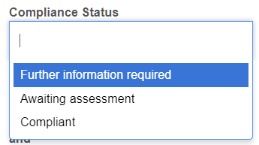
Compliance Status – Anonymous
Devices broken down into different compliance categories.
Further Information Required – more info required before device can be deemed compliant.
  Further details will not be shown to the public.
  Only manufacturer’s can see status/comments regarding their own device(s).
Awaiting Assessment
  Will be reviewed in due course.
  Due to large quantity of submissions, we are unable to provide a timescale for review completion.
Compliant
  Compliant to ENA’s best engineering judgement.
  No further action needs to be taken at this stage.
Notes:
ENA has recently established the G98/99 Database Consultancy Support. Project, the objectives of which are as follows:
1. Review manufacturer and supplier information submitted to the ENA G98/99
Database.
2. Assess information submitted in accordance with requirements of ENA documents
EREP G98 “Requirements for the connection of fully type tested micro-generators (up
to and including 16A per phase) in parallel with public Low Voltage Distribution
Networks on or after 27th April 2019” and EREP G99 “Requirements for the connection
of generation equipment in parallel with public distribution networks on or after 27th
April 2019”.
3. Provide a report on compliance of equipment with requirements of G98/99 or a report
of non-compliance where the equipment has partially or fully failed to meet the
requirements.
4. Communicate report to stakeholders

Slide 21
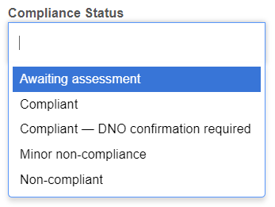
Compliance Status – Manufacturer/DNO
Devices broken down into different compliance categories.
Further Information Required – more info required before device can be deemed compliant:
  Non-compliant: Not compliant at this stage – please refer to ‘Compliance Status Comments’.
  Minor non-compliance or Document error:
    Documentation error stopping device from being fully compliant.
Awaiting Assessment
  Will be reviewed in due course.
  Due to large quantity of submissions, we are unable to provide a timescale for review completion.
Compliant
  Compliant to ENA’s best engineering judgement.
  No further action needs to be taken at this stage.
  ‘Compliant – on-site confirmation by DNO required’
Notes:
ENA has recently established the G98/99 Database Consultancy Support. Project, the objectives of which are as follows:
1. Review manufacturer and supplier information submitted to the ENA G98/99
Database.
2. Assess information submitted in accordance with requirements of ENA documents
EREP G98 “Requirements for the connection of fully type tested micro-generators (up
to and including 16A per phase) in parallel with public Low Voltage Distribution
Networks on or after 27th April 2019” and EREP G99 “Requirements for the connection
of generation equipment in parallel with public distribution networks on or after 27th
April 2019”.
3. Provide a report on compliance of equipment with requirements of G98/99 or a report
of non-compliance where the equipment has partially or fully failed to meet the
requirements.
4. Communicate report to stakeholders

Slide 22
Resolving Device Issues
If device is non-compliant, refer to compliance status comments.
Address the issues raised in the comments and re-submit to the TTR.
Device documentation will be reviewed again, ensure all errors are omitted before re-submitting – otherwise further delays.
If anything is unclear – submit a feedback request form stating device reference.
Only manufacturer’s can request information/feedback about their own devices.
! RE-UPLOADS OF SAME DEVICE UNDER NEW DEVICE REFERENCE !
  Will likely be deleting older device versions IF under separate device reference.
Notes:
ENA has recently established the G98/99 Database Consultancy Support. Project, the objectives of which are as follows:
1. Review manufacturer and supplier information submitted to the ENA G98/99
Database.
2. Assess information submitted in accordance with requirements of ENA documents
EREP G98 “Requirements for the connection of fully type tested micro-generators (up
to and including 16A per phase) in parallel with public Low Voltage Distribution
Networks on or after 27th April 2019” and EREP G99 “Requirements for the connection
of generation equipment in parallel with public distribution networks on or after 27th
April 2019”.
3. Provide a report on compliance of equipment with requirements of G98/99 or a report
of non-compliance where the equipment has partially or fully failed to meet the
requirements.
4. Communicate report to stakeholders

Slide 23
Compliant/Non-compliant Examples

Slide 24

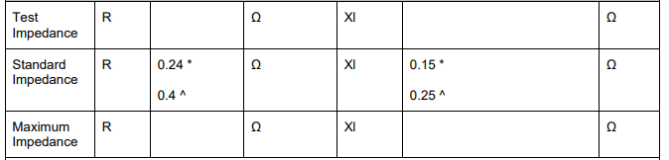
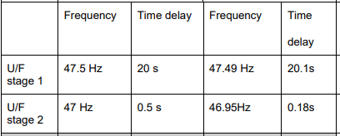
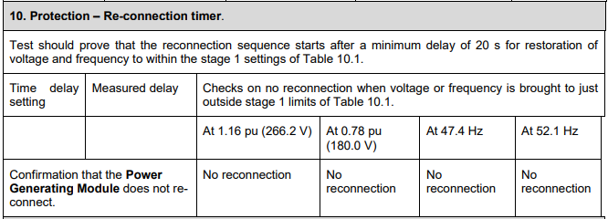
Non-compliant Application – Examples
1. Missing THD/PWHD values for PQ - Harmonics
2. Test impedance not declared – cannot determine whether normalised results are correct.
3. Device trips before minimum time delay of 0.5s.
4. Time & measured delay setting not declared – needs to be > 20s.
Notes:
ENA has recently established the G98/99 Database Consultancy Support. Project, the objectives of which are as follows:
1. Review manufacturer and supplier information submitted to the ENA G98/99
Database.
2. Assess information submitted in accordance with requirements of ENA documents
EREP G98 “Requirements for the connection of fully type tested micro-generators (up
to and including 16A per phase) in parallel with public Low Voltage Distribution
Networks on or after 27th April 2019” and EREP G99 “Requirements for the connection
of generation equipment in parallel with public distribution networks on or after 27th
April 2019”.
3. Provide a report on compliance of equipment with requirements of G98/99 or a report
of non-compliance where the equipment has partially or fully failed to meet the
requirements.
4. Communicate report to stakeholders

Slide 25
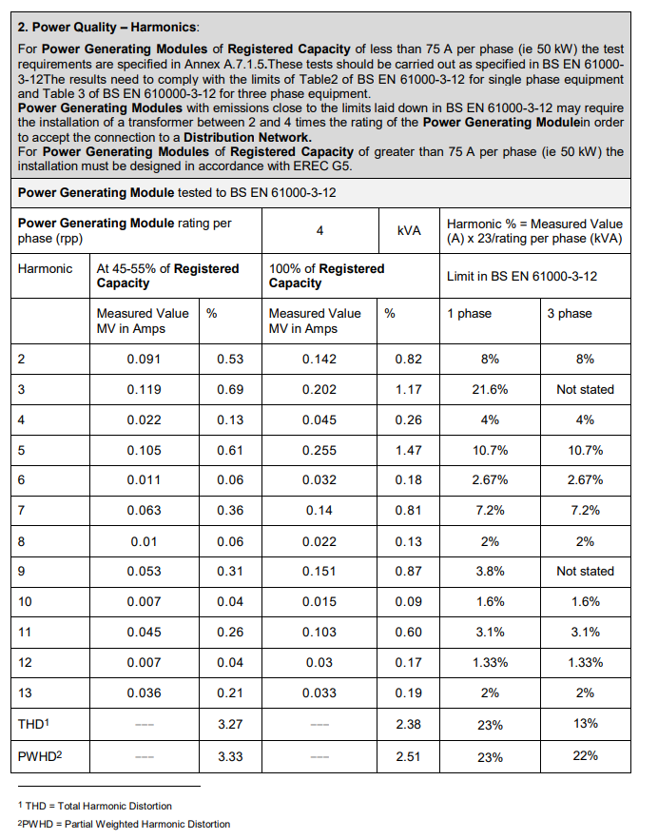
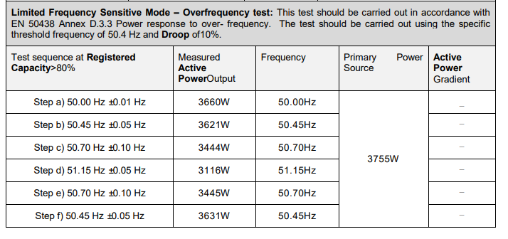
Non-compliant Application – Examples
2. Device declared as G98 (3.68kW single phase) however LFSM-O tests show active power output is greater – must be tested to G99 as no declaration of G100 power limitation device.
1. Missing phase 2/3 harmonic current data.
Notes:
ENA has recently established the G98/99 Database Consultancy Support. Project, the objectives of which are as follows:
1. Review manufacturer and supplier information submitted to the ENA G98/99
Database.
2. Assess information submitted in accordance with requirements of ENA documents
EREP G98 “Requirements for the connection of fully type tested micro-generators (up
to and including 16A per phase) in parallel with public Low Voltage Distribution
Networks on or after 27th April 2019” and EREP G99 “Requirements for the connection
of generation equipment in parallel with public distribution networks on or after 27th
April 2019”.
3. Provide a report on compliance of equipment with requirements of G98/99 or a report
of non-compliance where the equipment has partially or fully failed to meet the
requirements.
4. Communicate report to stakeholders

Slide 26
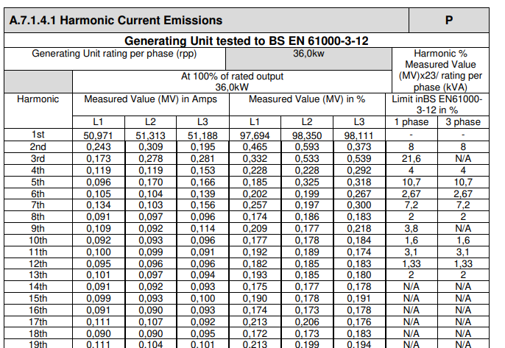
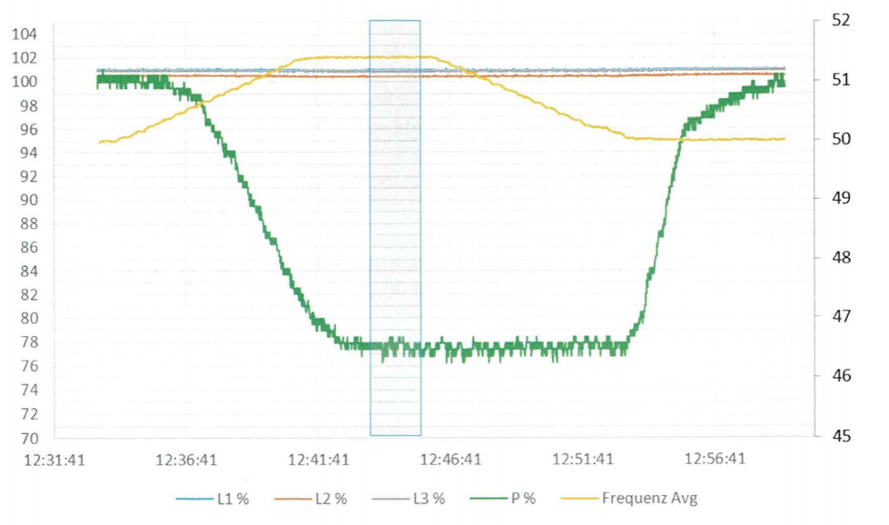
Compliant Application – Examples
1. Correctly supplied 3 phase harmonic data.
2. Clear & legible LFSM-O graph plot which shows correct active power output response (droop) to an increase in frequency.
Notes:
ENA has recently established the G98/99 Database Consultancy Support. Project, the objectives of which are as follows:
1. Review manufacturer and supplier information submitted to the ENA G98/99
Database.
2. Assess information submitted in accordance with requirements of ENA documents
EREP G98 “Requirements for the connection of fully type tested micro-generators (up
to and including 16A per phase) in parallel with public Low Voltage Distribution
Networks on or after 27th April 2019” and EREP G99 “Requirements for the connection
of generation equipment in parallel with public distribution networks on or after 27th
April 2019”.
3. Provide a report on compliance of equipment with requirements of G98/99 or a report
of non-compliance where the equipment has partially or fully failed to meet the
requirements.
4. Communicate report to stakeholders

Slide 27
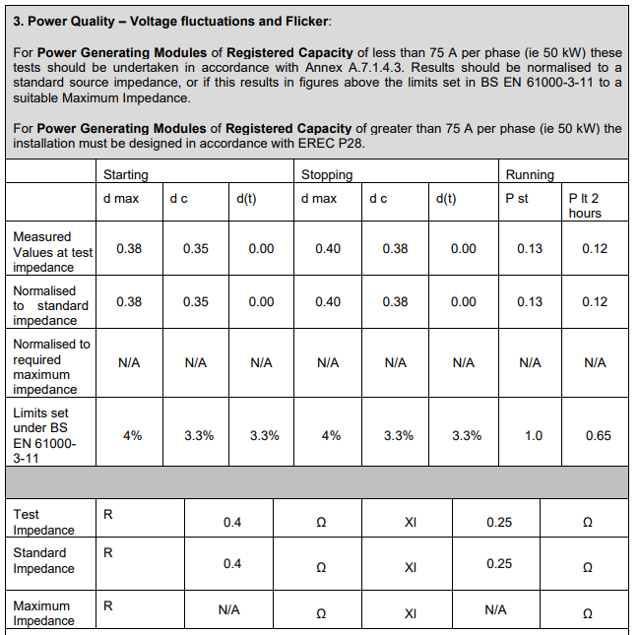
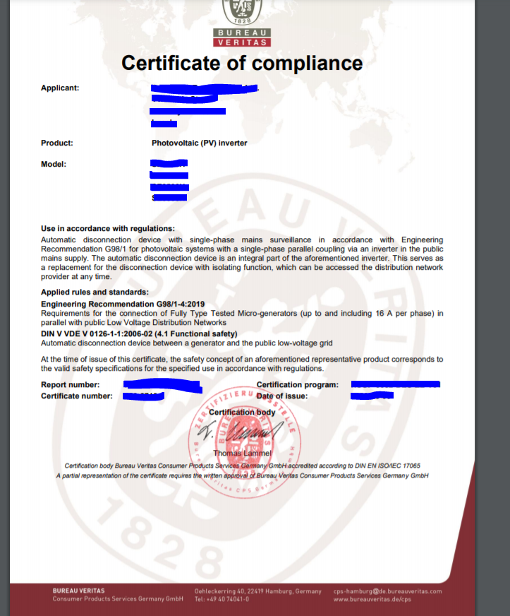
Compliant Application – Examples
1. Correctly declared test/standard impedance – results show correct normalisation.
2. Certificate of compliance - lists test date/location and all test data results.
Notes:
ENA has recently established the G98/99 Database Consultancy Support. Project, the objectives of which are as follows:
1. Review manufacturer and supplier information submitted to the ENA G98/99
Database.
2. Assess information submitted in accordance with requirements of ENA documents
EREP G98 “Requirements for the connection of fully type tested micro-generators (up
to and including 16A per phase) in parallel with public Low Voltage Distribution
Networks on or after 27th April 2019” and EREP G99 “Requirements for the connection
of generation equipment in parallel with public distribution networks on or after 27th
April 2019”.
3. Provide a report on compliance of equipment with requirements of G98/99 or a report
of non-compliance where the equipment has partially or fully failed to meet the
requirements.
4. Communicate report to stakeholders

Slide 28
Review Walkthrough
G98 Form C
3kW Energy Storage Device

Slide 29

Requirements for the connection of Fully Type Tested Micro-generators (up to and including 16 A per phase) in parallel with public Low Voltage Distribution Networks on or after 27 April 2019
Example Submission; G98 Form C
Type Test Verification Report

Slide 30
Stages of Assessment
Operating Range
Power Quality – Harmonics
Power Quality – Voltage Fluctuations & Flicker
Power Quality – DC Injection
Power Quality – Power Factor
Protection – Frequency Tests
Protection – Voltage Tests
Protection – Loss of Mains Test
Limited Frequency Sensitive Mode – Overfrequency (LFSM-O) Test
Power Output with Falling Frequency Test
Reconnection Timer
Fault Level Contribution
Logic Interface
Self-Monitoring solid state switching
Notes:
ENA has recently established the G98/99 Database Consultancy Support. Project, the objectives of which are as follows:
1. Review manufacturer and supplier information submitted to the ENA G98/99
Database.
2. Assess information submitted in accordance with requirements of ENA documents
EREP G98 “Requirements for the connection of fully type tested micro-generators (up
to and including 16A per phase) in parallel with public Low Voltage Distribution
Networks on or after 27th April 2019” and EREP G99 “Requirements for the connection
of generation equipment in parallel with public distribution networks on or after 27th
April 2019”.
3. Provide a report on compliance of equipment with requirements of G98/99 or a report
of non-compliance where the equipment has partially or fully failed to meet the
requirements.
4. Communicate report to stakeholders

Slide 31
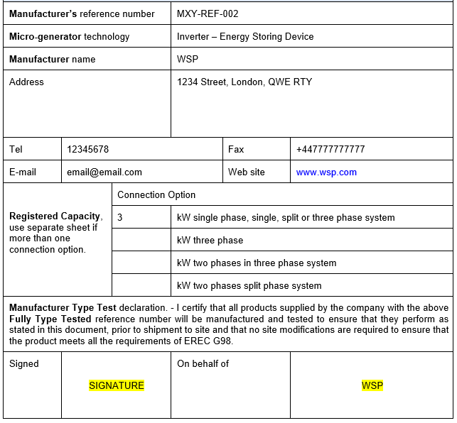
Front Page
The front page of the Type Test Verification report must be filled out and signed on behalf of the manufacturer/testing centre.
Note: this device is a 3kW Inverter – Energy Storage Device

Slide 32
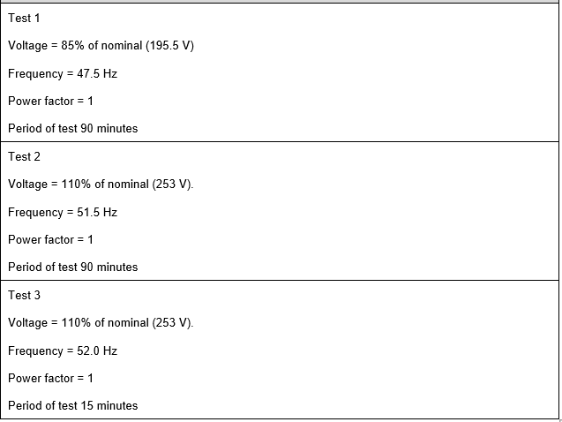
1. Operating Range
Pass.
Device operates normally.
No disconnection occurred.
Pass.
Device operates normally.
No disconnection occurred.
Pass.
Device operates normally.
No disconnection occurred.
Tests to see whether device can operate within required ranges over specified time;
Statement that device stays connected and/or;
Graphical evidence

Slide 33
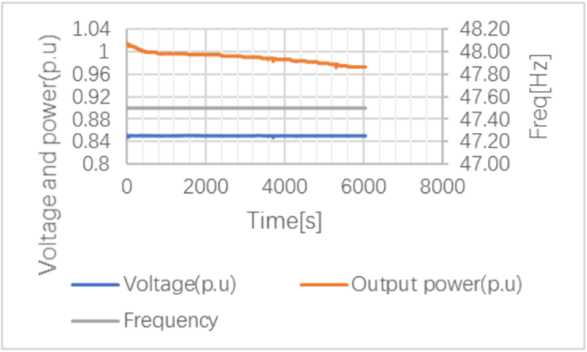
Test 1;
Voltage = 85% of nominal (195.5V)
Frequency = 47.5Hz
Power factor = 1
Period of test 90 minutes
Notes:
ENA has recently established the G98/99 Database Consultancy Support. Project, the objectives of which are as follows:
1. Review manufacturer and supplier information submitted to the ENA G98/99
Database.
2. Assess information submitted in accordance with requirements of ENA documents
EREP G98 “Requirements for the connection of fully type tested micro-generators (up
to and including 16A per phase) in parallel with public Low Voltage Distribution
Networks on or after 27th April 2019” and EREP G99 “Requirements for the connection
of generation equipment in parallel with public distribution networks on or after 27th
April 2019”.
3. Provide a report on compliance of equipment with requirements of G98/99 or a report
of non-compliance where the equipment has partially or fully failed to meet the
requirements.
4. Communicate report to stakeholders

Slide 34
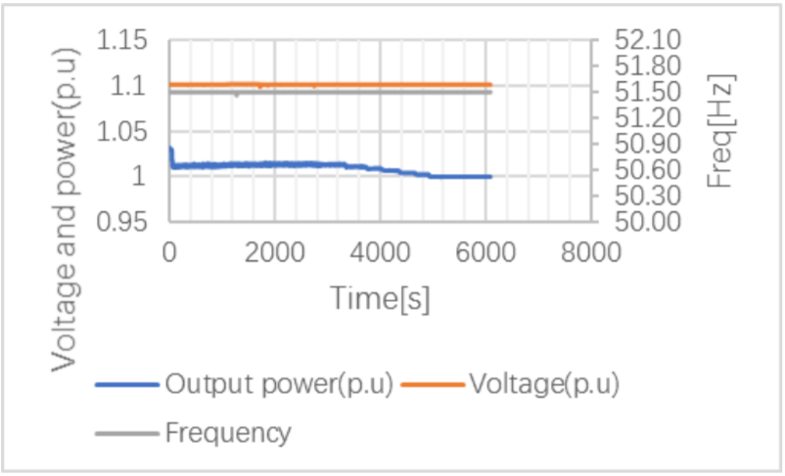
Test 2;
Voltage = 110% of nominal (253V)
Frequency = 51.5Hz
Power factor = 1
Period of test 90 minutes
Notes:
ENA has recently established the G98/99 Database Consultancy Support. Project, the objectives of which are as follows:
1. Review manufacturer and supplier information submitted to the ENA G98/99
Database.
2. Assess information submitted in accordance with requirements of ENA documents
EREP G98 “Requirements for the connection of fully type tested micro-generators (up
to and including 16A per phase) in parallel with public Low Voltage Distribution
Networks on or after 27th April 2019” and EREP G99 “Requirements for the connection
of generation equipment in parallel with public distribution networks on or after 27th
April 2019”.
3. Provide a report on compliance of equipment with requirements of G98/99 or a report
of non-compliance where the equipment has partially or fully failed to meet the
requirements.
4. Communicate report to stakeholders

Slide 35
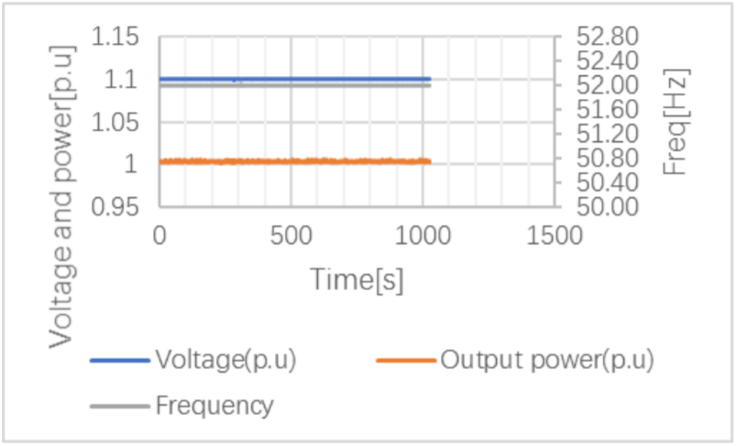
Test 3;
Voltage = 110% of nominal (253V)
Frequency = 52Hz
Power factor = 1
Period of test 15 minutes
Notes:
ENA has recently established the G98/99 Database Consultancy Support. Project, the objectives of which are as follows:
1. Review manufacturer and supplier information submitted to the ENA G98/99
Database.
2. Assess information submitted in accordance with requirements of ENA documents
EREP G98 “Requirements for the connection of fully type tested micro-generators (up
to and including 16A per phase) in parallel with public Low Voltage Distribution
Networks on or after 27th April 2019” and EREP G99 “Requirements for the connection
of generation equipment in parallel with public distribution networks on or after 27th
April 2019”.
3. Provide a report on compliance of equipment with requirements of G98/99 or a report
of non-compliance where the equipment has partially or fully failed to meet the
requirements.
4. Communicate report to stakeholders

Slide 36
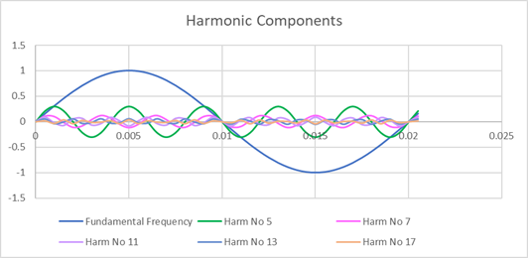
2. Power Quality - Harmonics
Manufacturers must supply harmonics for all 3 phases and they must comply with the limits stated in Table 2 of BS EN 61000-3-2.
Data is required from #2 - #40 harmonics

Slide 37
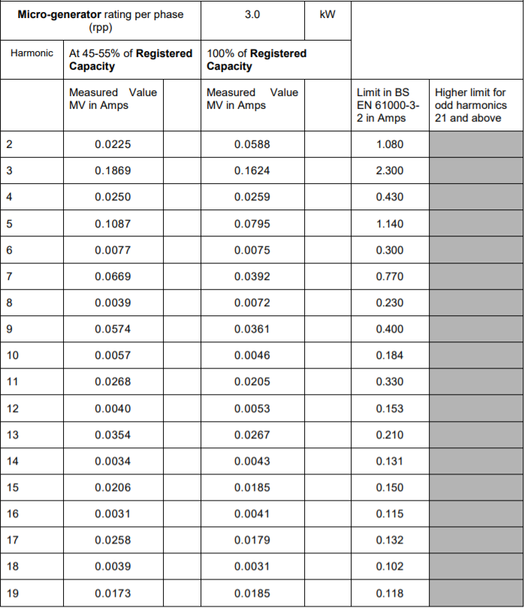
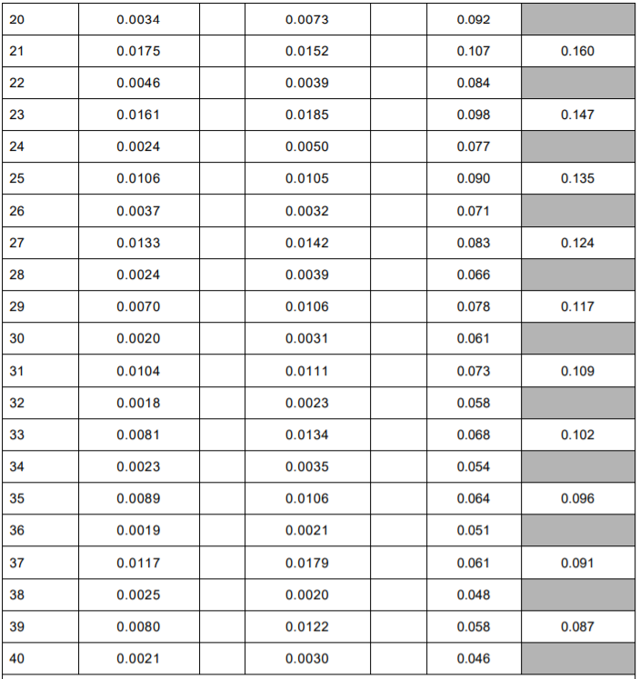
2. PQ - Harmonics
Measured values < Limit in BS EN 61000-3-2
Higher limits only allowed under certain exemptions (see 6.2.3.4 61000-3-2)
Notes:
ENA has recently established the G98/99 Database Consultancy Support. Project, the objectives of which are as follows:
1. Review manufacturer and supplier information submitted to the ENA G98/99
Database.
2. Assess information submitted in accordance with requirements of ENA documents
EREP G98 “Requirements for the connection of fully type tested micro-generators (up
to and including 16A per phase) in parallel with public Low Voltage Distribution
Networks on or after 27th April 2019” and EREP G99 “Requirements for the connection
of generation equipment in parallel with public distribution networks on or after 27th
April 2019”.
3. Provide a report on compliance of equipment with requirements of G98/99 or a report
of non-compliance where the equipment has partially or fully failed to meet the
requirements.
4. Communicate report to stakeholders

Slide 38
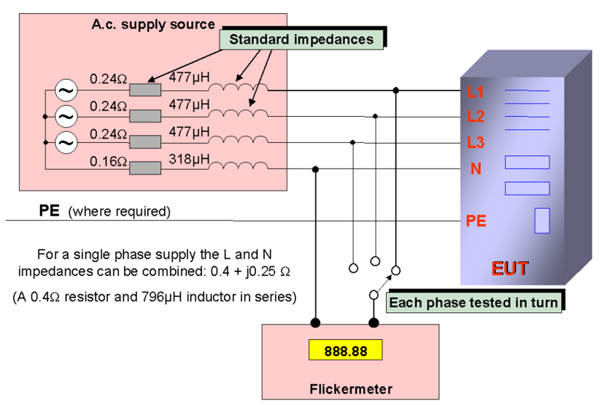
3. Power Quality – Voltage Fluctuations and Flicker
Device (EUT) connected to reference to measure voltage fluctuations and flicker.
These tests should be undertake in accordance with G98 Annex A1 A.1.3.3 and results should be normalised to standard source impedance.
1-phase test impedance = 0.4Ω
3-phase test impedance = 0.24Ω

Slide 39
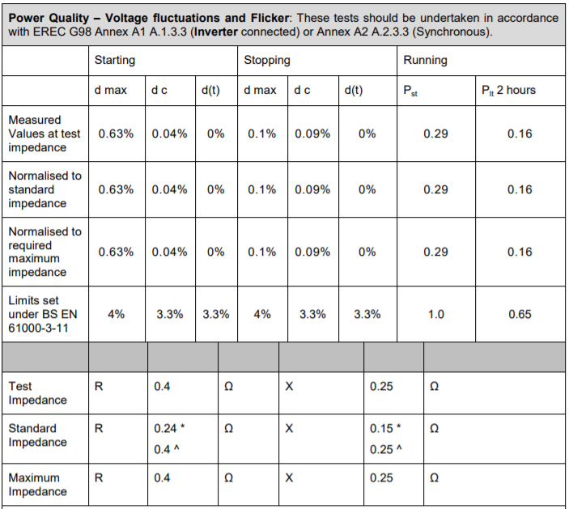
3. Power Quality – Voltage Fluctuations and Flicker
If both 0.24Ω & 0.4Ω declared, use best engineering judgement to determine whether correct value was used.
Otherwise, contact manufacturer for clarification.
Typically within limits.

Slide 40
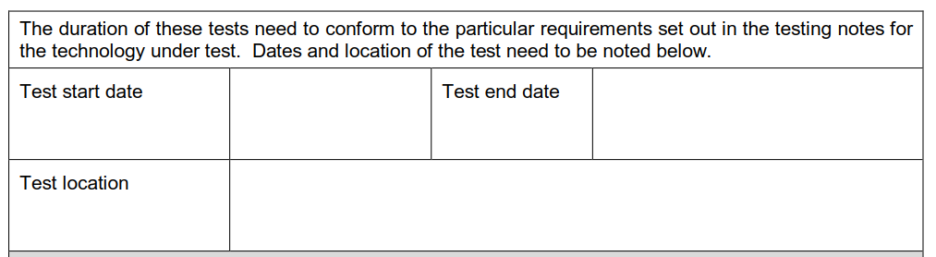
3. Power Quality – Voltage Fluctuations and Flicker
06/04/20
06/04/20
1234 Street, London, QWE RTY
Test date and location must be declared

Slide 41
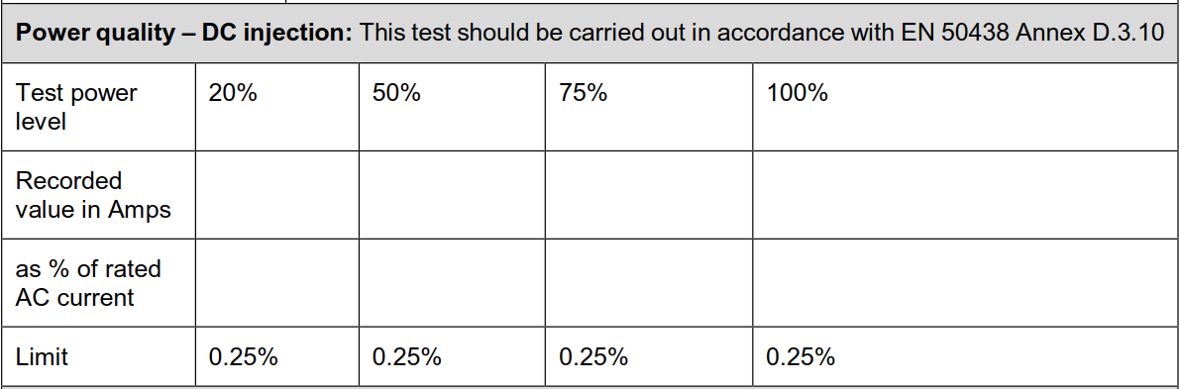
4. Power Quality – DC Injection
Only applicable for Inverters & Micro-generators;
DC Injection a product of electrical inversion;
Tested at 4 power levels for G98.
0.0077
0.0038
0.0020
0.0010
0.06%
0.03%
0.02%
0.01%
I (Calculated Base Current) = (Registered Capacity x 1000 / 230)
DC Injection = DC recorded value in mA / Calculated Base Current
Some manufacturers calculate % of rated AC current 3x larger due to incorrect calc – number 3x larger than actual.

Slide 42
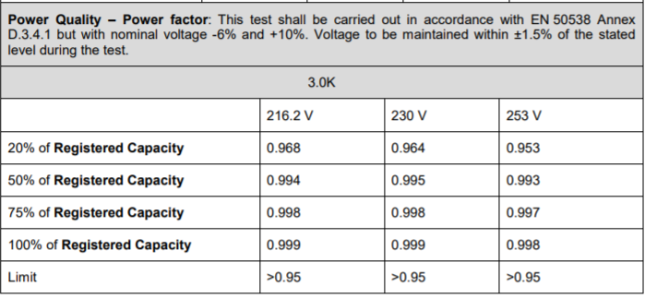
5. Power Quality – Power Factor
Ensures device is operational under specified conditions;
Test at 4 power levels (20%, 50%, 75% & 100%);
Test at 3 voltage levels (216.2V, 230V & 253V).
Power factor must stay above 0.95.

Slide 43
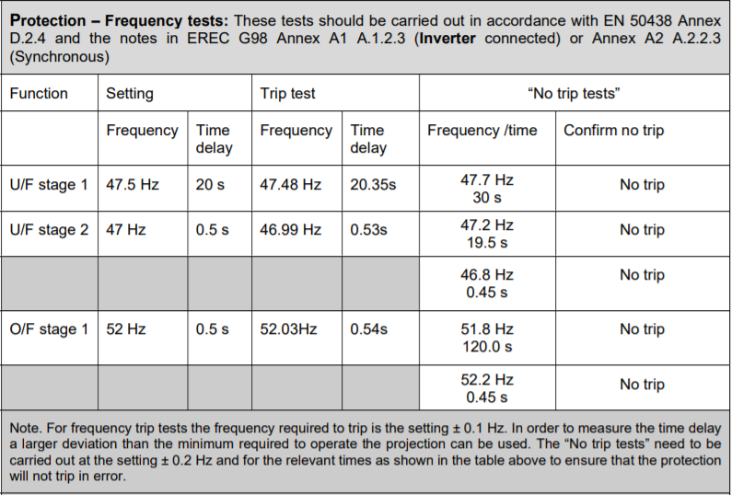
6. Protection – Frequency Tests
Tests device response to over and under frequency;
Trip & no trip tests;
Trip: Statement of frequency/time delay OK;
No Trip: Statement of No Trip OK
Acceptable range of +/- 0.1Hz

Slide 44
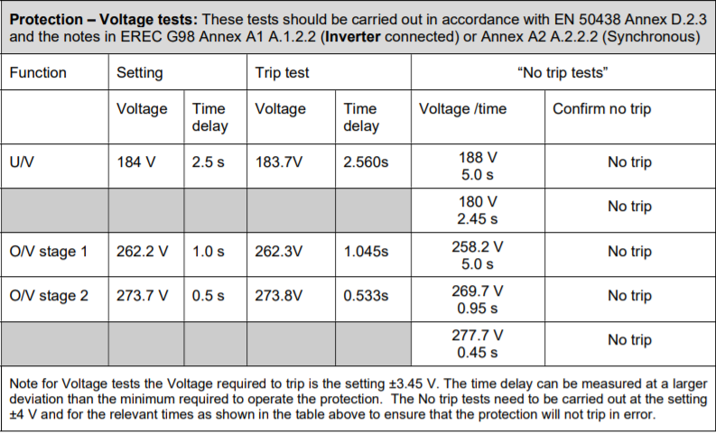
7. Protection – Voltage Tests
Tests device response to over and under voltage;
Trip & no trip tests;
Trip: Statement of voltage/time delay OK;
No Trip: Statement of No Trip OK
Acceptable range of +/- 3.45V

Slide 45
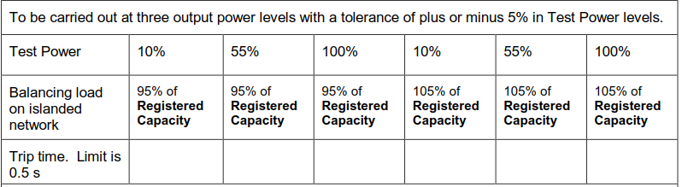
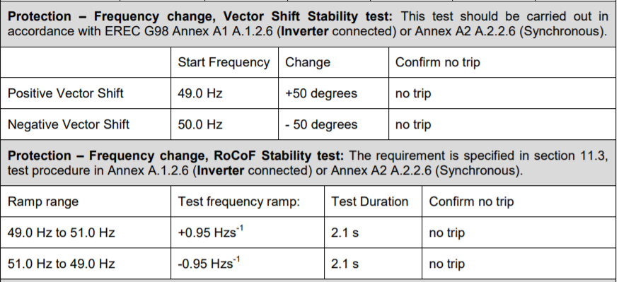
8. Protection – Loss of Mains Tests
0.138s
0.149s
0.403s
0.278s
0.331s
0.288s
Non-PV Inverters – trip within 0.5s
In accordance with EN 50438
Stability tests due to natural variation of frequency in system;
Prevents unnecessary tripping;
Confirmed no trip

Slide 46
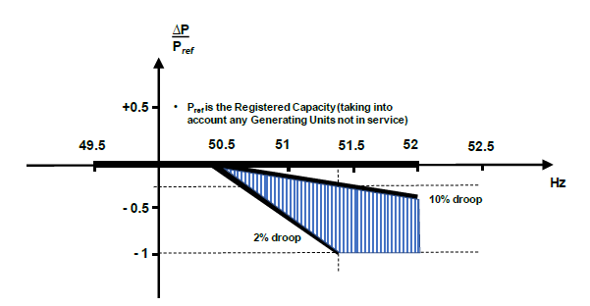
9. Limited Frequency Sensitive Mode – Overfrequency
(LFSM-O) Test
More demand for electricity - frequency will fall;
Higher generation than demand – frequency will rise;
The test should be carried out using the specific threshold frequency of 50.4Hz and droop of 10%.
Each PGM shall be capable of reducing Active Power Output in response to a rise in frequency.

Slide 47
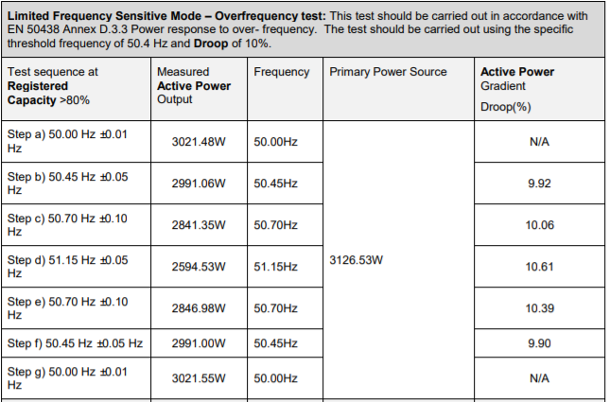
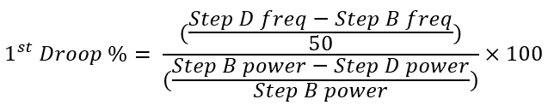
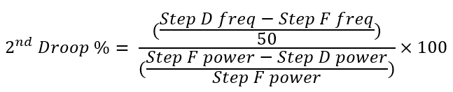
9. Limited Frequency Sensitive Mode – Overfrequency
(LFSM-O) Test

Slide 48
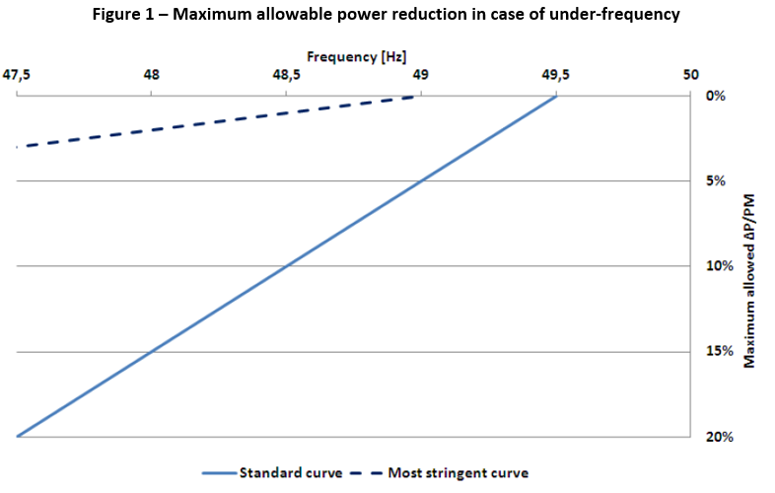
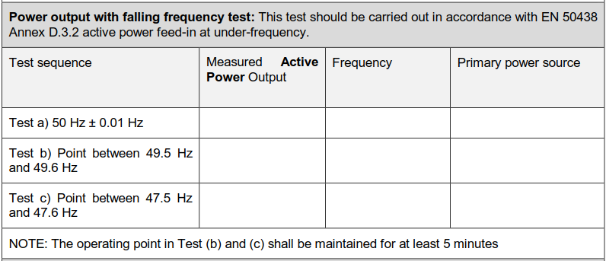
10. Power Output with Falling Frequency Test
Device should maintain constant output (49.5 Hz – 50.4 Hz);
Below/beyond this, should not fall outside of limits.
3000 W
50.02 Hz
3001 W
2998 W
49.52 Hz
3001 W
2900 W
47.51 Hz
3001 W

Slide 49
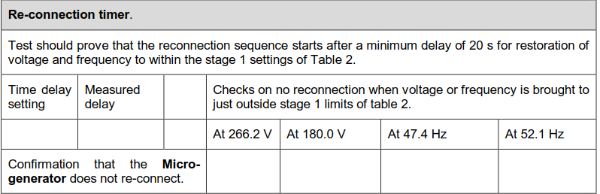
11. Reconnection Timer
30s
32s
No Reconnection
No Reconnection
No Reconnection
No Reconnection
Reconnection sequence begins after minimum delay of 20s;
Bring device to just outside of voltage/frequency limits and ensure device does not reconnect;
Statement of “No Reconnection” is ok.

Slide 50
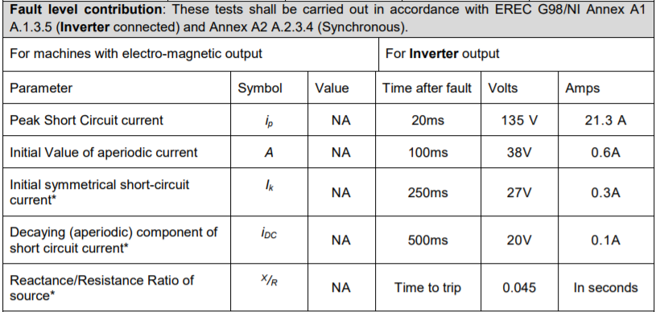
12. Fault Level Contribution
Generally have small short circuit fault contributions;
DNOs require that fault level contribution is provided regardless;
To avoid exceeding design fault levels and other circuit components.

Slide 51
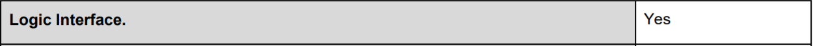
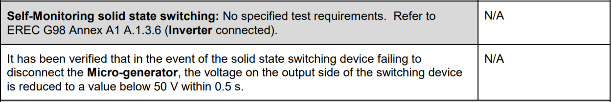
13. Logic Interface
Logic interface (input port) - cease active power output within 5s;
Compulsory;
Must state “Yes” for device to be compliant.
14. Self-Monitoring Solid State Switching
Solid state switch to disconnect from DNOs distribution network;
Typically N/A for Inverters.

Slide 52
Review Walkthrough
G99 Form A2-3
18kW 3-phase Inverter

Slide 53
Requirements for the connection of generation equipment in parallel with public distribution networks on or after 27 April 2019
Example Submission; A2-3 Compliance Verification Report – Tests for Type A Inverter Connected Power Generating Modules

Slide 54
Stages of Assessment
Operating Range
Power Quality – Harmonics
Power Quality – Voltage Fluctuations & Flicker
Power Quality – DC Injection
Power Quality – Power Factor
Protection – Frequency Tests
Protection – Voltage Tests
Protection – Loss of Mains Test
Limited Frequency Sensitive Mode – Overfrequency (LFSM-O) Test
Reconnection Timer
Fault Level Contribution
Self-Monitoring solid state switching
Wiring Functionality Tests
Logic Interface
Notes:
ENA has recently established the G98/99 Database Consultancy Support. Project, the objectives of which are as follows:
1. Review manufacturer and supplier information submitted to the ENA G98/99
Database.
2. Assess information submitted in accordance with requirements of ENA documents
EREP G98 “Requirements for the connection of fully type tested micro-generators (up
to and including 16A per phase) in parallel with public Low Voltage Distribution
Networks on or after 27th April 2019” and EREP G99 “Requirements for the connection
of generation equipment in parallel with public distribution networks on or after 27th
April 2019”.
3. Provide a report on compliance of equipment with requirements of G98/99 or a report
of non-compliance where the equipment has partially or fully failed to meet the
requirements.
4. Communicate report to stakeholders

Slide 55
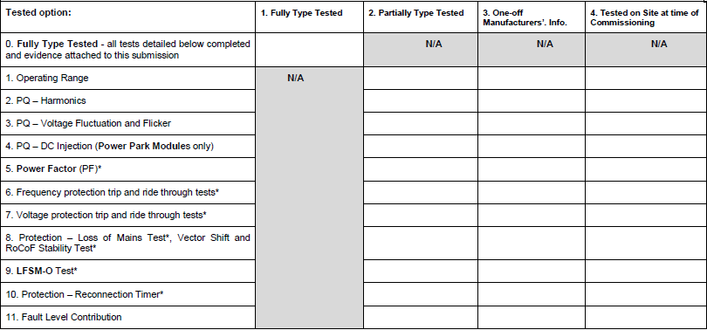
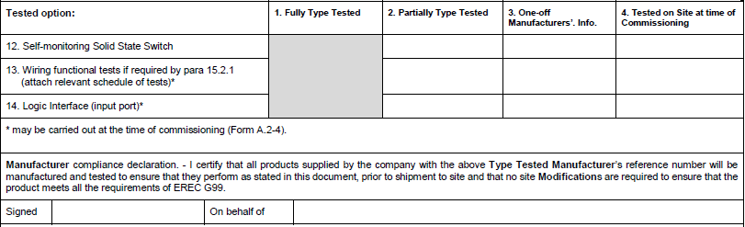
Front Page
X
In order for the device to be classified as Fully Type Tested – Tests 1-14 must be completed.
The option for Partially Type Tested is available and the manufacturer must declare which tests have been completed as part of this.
For this example, the device will be Fully Type Tested.

Slide 56
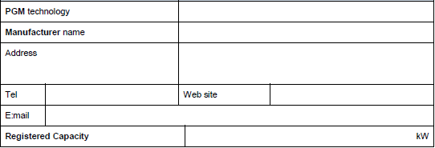
Front Page
Inverter
WSP
1234 Street, London, QWE RTY
1235678
www.wsp.com
wsp@wsp.com
18kW
Vital that all information is provided;
This example submission is for a 3-phase Inverter rated at 18kW.

Slide 57

1. Operating Range
Pass – Graphical Evidence Provided
Pass – Graphical Evidence Provided
Pass – Graphical Evidence Provided
Pass – Graphical Evidence Provided
Pass – Graphical Evidence Provided
Tests 2, 3 & 4 = G98 Type C Tests 1, 2 & 3
Test 1 & 5 added for G99.

Slide 58

Test 1;
Voltage = 85% of nominal (195.5V)
Frequency = 47Hz
Power factor = 1
Period of test 20s
Notes:
ENA has recently established the G98/99 Database Consultancy Support. Project, the objectives of which are as follows:
1. Review manufacturer and supplier information submitted to the ENA G98/99
Database.
2. Assess information submitted in accordance with requirements of ENA documents
EREP G98 “Requirements for the connection of fully type tested micro-generators (up
to and including 16A per phase) in parallel with public Low Voltage Distribution
Networks on or after 27th April 2019” and EREP G99 “Requirements for the connection
of generation equipment in parallel with public distribution networks on or after 27th
April 2019”.
3. Provide a report on compliance of equipment with requirements of G98/99 or a report
of non-compliance where the equipment has partially or fully failed to meet the
requirements.
4. Communicate report to stakeholders

Slide 59

Test 2;
Voltage = 85% of nominal (195.5V)
Frequency = 47.5Hz
Power factor = 1
Period of test 90 minutes
Notes:
ENA has recently established the G98/99 Database Consultancy Support. Project, the objectives of which are as follows:
1. Review manufacturer and supplier information submitted to the ENA G98/99
Database.
2. Assess information submitted in accordance with requirements of ENA documents
EREP G98 “Requirements for the connection of fully type tested micro-generators (up
to and including 16A per phase) in parallel with public Low Voltage Distribution
Networks on or after 27th April 2019” and EREP G99 “Requirements for the connection
of generation equipment in parallel with public distribution networks on or after 27th
April 2019”.
3. Provide a report on compliance of equipment with requirements of G98/99 or a report
of non-compliance where the equipment has partially or fully failed to meet the
requirements.
4. Communicate report to stakeholders

Slide 60

Test 3;
Voltage = 110% of nominal (253V)
Frequency = 51.5Hz
Power factor = 1
Period of test 90 minutes
Notes:
ENA has recently established the G98/99 Database Consultancy Support. Project, the objectives of which are as follows:
1. Review manufacturer and supplier information submitted to the ENA G98/99
Database.
2. Assess information submitted in accordance with requirements of ENA documents
EREP G98 “Requirements for the connection of fully type tested micro-generators (up
to and including 16A per phase) in parallel with public Low Voltage Distribution
Networks on or after 27th April 2019” and EREP G99 “Requirements for the connection
of generation equipment in parallel with public distribution networks on or after 27th
April 2019”.
3. Provide a report on compliance of equipment with requirements of G98/99 or a report
of non-compliance where the equipment has partially or fully failed to meet the
requirements.
4. Communicate report to stakeholders

Slide 61

Test 4;
Voltage = 110% of nominal (253V)
Frequency = 52Hz
Power factor = 1
Period of test 15 minutes
Notes:
ENA has recently established the G98/99 Database Consultancy Support. Project, the objectives of which are as follows:
1. Review manufacturer and supplier information submitted to the ENA G98/99
Database.
2. Assess information submitted in accordance with requirements of ENA documents
EREP G98 “Requirements for the connection of fully type tested micro-generators (up
to and including 16A per phase) in parallel with public Low Voltage Distribution
Networks on or after 27th April 2019” and EREP G99 “Requirements for the connection
of generation equipment in parallel with public distribution networks on or after 27th
April 2019”.
3. Provide a report on compliance of equipment with requirements of G98/99 or a report
of non-compliance where the equipment has partially or fully failed to meet the
requirements.
4. Communicate report to stakeholders

Slide 62

Test 5;
RoCoF withstand
Confirm that the PGM is capable of staying connected to the Distribution Network and operate at rates of change of frequency up to 1Hzs-1 as measured over a period of 500ms
Notes:
ENA has recently established the G98/99 Database Consultancy Support. Project, the objectives of which are as follows:
1. Review manufacturer and supplier information submitted to the ENA G98/99
Database.
2. Assess information submitted in accordance with requirements of ENA documents
EREP G98 “Requirements for the connection of fully type tested micro-generators (up
to and including 16A per phase) in parallel with public Low Voltage Distribution
Networks on or after 27th April 2019” and EREP G99 “Requirements for the connection
of generation equipment in parallel with public distribution networks on or after 27th
April 2019”.
3. Provide a report on compliance of equipment with requirements of G98/99 or a report
of non-compliance where the equipment has partially or fully failed to meet the
requirements.
4. Communicate report to stakeholders

Slide 63

2. Power Quality - Harmonics
6
6
6
0.189
0.65%
0.183
0.63%
0.061
0.21%
0.049
0.17%
0.080
0.28%
0.082
0.28%
0.075
0.26%
0.077
0.75%
0.27%
0.209
0.72%
0.217
0.025
0.09%
0.018
0.037
0.06%
0.13%
0.046
0.16%
0.088
0.30%
0.092
0.095
0.32%
0.33%
0.091
0.31%
0.98%
0.288
0.99%
0.283
0.088
0.31%
0.083
0.29%
0.057
0.054
0.19%
0.052
0.18%
0.043
0.15%
0.20%
0.027
0.09%
0.030
0.029
0.10%
0.24%
0.10%
0.26%
0.10%
0.068
0.028
0.076
0.030
0.094
0.093
0.13%
0.32%
0.10%
0.32%
0.037
0.015
0.024
0.08%
0.05%
0.048
0.025
0.044
0.056
0.023
0.19%
0.042
0.15%
0.17%
0.09%
0.15%
0.08%
0.103
0.008
0.03%
0.097
0.019
0.33%
0.06%
0.36%
0.027
0.09%
0.028
0.10%
0.026
0.014
0.023
0.044
0.05%
0.022
0.08%
0.08%
0.15%
0.041
0.14%
0.09%
0.069
0.24%
0.020-
0.078
0.07%
1.09%
0.028
0.10%
0.27%
0.329
2.31%
0.316
0.036
0.013
0.05%
0.035
0.026
0.09%
0.12%
0.23%
0.062
0.022%
0.079
0.27%
0.073
0.25%
0.067
0.09%
0.028
0.345
1.19%
0.026
0.334
0.19%
1.15%
0.10%
0.049
0.17%
0.055
1.28%
0.0388
1.34%
0.371
2.54%
0.288
0.99%
0.283
0.98%
Harmonic current data supplied for all 3 phases;
Including Total Harmonic Distortion & Partially Weighted Harmonic Distortion

Slide 64

4. Power Quality – DC Injection
0.0168
0.0216
0.1146
0.0215%
0.0276%
0.15%
DC Injection a product of electrical inversion.
Tested at 3 power levels (10%, 55% & 100%)

Slide 65

5. Power Quality – Power Factor
0.999
0.999
0.999
Tests carried out at 3 voltage levels;
At registered capacity.

Slide 66

8. Protection – Loss of Mains Test
0.152
0.302
0.385
0.166s
0.298s
0.359s
PV Inverter
Slightly different tests to Non-PV inverter;
Still trip within 0.5s;
Tested in accordance with BS EN 62116;
Evaluates efficiency of islanding prevention methods.

Slide 67

13. Wiring Functionality Tests
Applicable for components that are wired together on site;
When not using designed plugs and sockets;
Manufacturer will need to submit schedule of wiring connections to be made to DNO;
Typically N/A.

Slide 68
Devices > 50kW
Requirements of P28 & G5

Slide 69
EREC P28 2018
“Voltage fluctuations and the connection of disturbing equipment to transmission systems and distribution networks in the United Kingdom”
Supersedes EREC P28 1989
Replaces 2. PQ – Voltage Fluctuations & Flicker from device application form.
References;
  BS EN IEC 61000-3-11 (≤ 75A)
  BS EN IEC 61000-3-5 (> 75A)
At time of device application, location of connection into the grid (PCC) is unknown.
This will be at the discretion of the DNO’s.
‘Pending – DNO assessment of P28’

Slide 70

G5/5
Introduction of the harmonic specification (issued by NO);
Voltage levels & ranges have been defined;
Planning & computability levels for harmonics have raised (THD unchanged);
Apportionment of harmonic headroom (Stage 3);
Harmonics up to 100th order (5kHz);
Subharmonic & interharmonic groupings are defined;
General aggregation rule.
This will be at the discretion of the DNO’s.
‘Pending – DNO assessment of G5’

Slide 71
DNO Assessment of G5/P28
WSP have been commissioned to review Type Test documentation.
This does not include the assessment of G5 (harmonics) & P28 (voltage fluctuation & flicker studies).
Each of these tests will be at performed at the discretion of the DNO.
WSP will review devices up to this point
Marked as ‘Compliant – DNO confirmation required’.
Notes:
ENA has recently established the G98/99 Database Consultancy Support. Project, the objectives of which are as follows:
1. Review manufacturer and supplier information submitted to the ENA G98/99
Database.
2. Assess information submitted in accordance with requirements of ENA documents
EREP G98 “Requirements for the connection of fully type tested micro-generators (up
to and including 16A per phase) in parallel with public Low Voltage Distribution
Networks on or after 27th April 2019” and EREP G99 “Requirements for the connection
of generation equipment in parallel with public distribution networks on or after 27th
April 2019”.
3. Provide a report on compliance of equipment with requirements of G98/99 or a report
of non-compliance where the equipment has partially or fully failed to meet the
requirements.
4. Communicate report to stakeholders

Slide 72
Thank you!

